Slide 1
BOOTCAMP

Slide 2
Overview of the 2-week Sprint
Introduction to Agile and HTML
HTML and CSS
Portfolio project
JavaScript Basics
JavaScript project
Deployment, Review & Retrospective

Slide 3
BOOTCAMP TAKEAWAY
Solid Foundation in Web Development
Agile Methodologies Understanding
Personal Portfolio Website - https://portfolio2511.netlify.app/
JavaScript Project
Problem-Solving and Debugging Skills
Networking and Collaboration

Slide 4
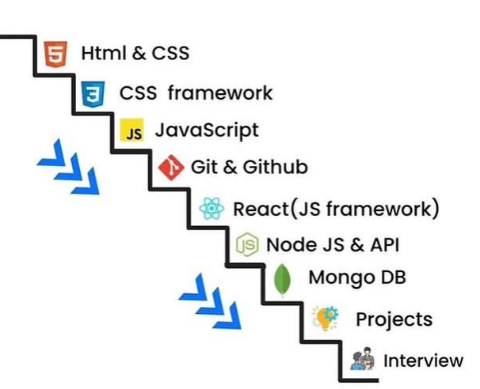
WEB DEVELOPMENT ROADMAP

